Slide 1


“X-Random Forest: An Explainable AI Framework for Early Stage Diabetes Prediction with Hyperparameter Tuning and Cross-validation”
Prepared for: Thesis Defense Committee
Department of Computer Science and Engineering
IUBAT-International University of Business Agriculture and Technology
Supervised By
Presented By:
Faniyam Maria Mansia
Lecturer
Department of Computer Science & Engineering, IUBAT
Osman Gani Mridul | 21103005
Md Shahriar Hoque | 21103092

Slide 2
CONTENTS
ABSTRACT
INTRODUCTION
OBJECTIVE OF THE STUDY
PROBLEM STATEMENT
LITERATURE REVIEW
METHODOLOGY
PROPOSED MODEL
RESULT AND DISCUSSION
COMPARATIVE ANALYSIS
CONCLUSION
REFERENCES

Slide 3
ABSTRACT
Diabetes currently affects over 422 million people worldwide, presenting a significant global health challenge . Traditional detection methods lack insight into contributing factors, limiting prevention. This study introduces an Explainable Random Forest (XRF) model with 98.59% accuracy, using Explainable AI (XAI) to reveal key diabetes risk factors, aiding prevention and management.
Index Terms—Explainable Random Forest (XRF), Diabetes Prediction, Explainable Artificial Intelligence (XAI), Hyperparameter Tuning, Cross-validation.
3

Slide 4
INTRODUCTION
Diabetes currently impacts over 422 million people globally, and this figure is expected to rise to 490 million by 2030, posing a significant health challenge. Traditional diagnostic methods depend heavily on expert analysis, which may overlook early indicators. This study presents an enhanced Random Forest model paired with explainable AI to improve diabetes prediction accuracy. By identifying critical factors, this approach aims to support earlier interventions and improve disease management outcomes.

Slide 5
OBJECTIVE OF THE STUDY
Develop an Explainable Random Forest (XRF) model for accurate diabetes prediction.
Use AI to identify important factors that lead to diabetes.
Use Explainable AI (XAI) methods to help understand how the model makes predictions.
Provide helpful advice for people at risk of diabetes and support those who have it.
Make sure the data is well-prepared for training and testing the model.
Compare the XRF model with other classifiers to show how well it works.
Use 10-fold cross-validation to make sure the model performs reliably.

Slide 6
PROBLEM STATEMENT
Diabetes is one of the most common diseases, affecting over 422 million people and leading to serious health issues.
Machine learning can predict diabetes, but traditional methods struggle to find key contributing factors.
Previous models did not identify important factors; they focused mainly on making predictions.
The study aims to create an Explainable Random Forest (XRF) model to improve predictions by clarifying results that earlier models could not explain.

Slide 7
LITERATURE REVIEW-1
Paper -1
Title | “Early detection of type 2 diabetes mellitus using machine learning based prediction models”
Authors | Leon Kopitar, Primož Kočbek, Leona Čilar, Aziz Sheikh, Gregor Stiglic.
Published | 20 July, 2020 at SCIENTIFIC REPORTS on report research.
Methodology | The dataset included electronic health records of 27,050 adults without a previous diagnosis of Type 2 Diabetes Mellitus (T2DM), collected from December 2014 to September 2017. The study compared Glmnet and Random Forest (RF) machine learning algorithms to traditional regression models for predicting fasting plasma glucose levels.
Analysis | The performance of the machine learning models was assessed using root mean square error (RME) for accuracy, while stability in variable selection was evaluated to determine the robustness of each model with complex datasets.
Result | Random Forest had a Root Mean Square Error lower of 0.842 compared to Glmnet's 0.859 and showed greater stability in variable selection.

Slide 8
LITERATURE REVIEW-1 (Cond..)
LIMITATIONS
Reliance on one dataset may limit the generalizability of the findings.
Emphasis on specific machine learning algorithms may overlook other potentially effective models.
The complexity of machine learning models can hinder their acceptance in clinical practice due to issues with interpretability.

Slide 9
LITERATURE REVIEW-2
Paper -10
Title | “Comparative analysis in the prediction of early-stage diabetes using multiple machine learning techniques”
Authors | Leonard Flores, Rowell Marquez, Lloyd Macatangay, Shiela Marie, Jonnah R. Melo.
Published | 31st July ,2023 at Indonesian Journal of Electrical Engineering and Computer Science
Methodology | Data from 520 individuals with diabetes-related symptoms was collected at Sylhet Diabetes Hospital in Sylhet, Bangladesh. The study performed a comparative analysis of several machine learning techniques, including Random Forest, Support Vector Machines (SVM), Naïve Bayes, K-Nearest Neighbors (KNN), and Neural Networks.
Analysis | The study evaluated the effectiveness of each machine learning technique in diagnosing diabetes based on prediction accuracy. It emphasized the importance of feature selection and model evaluation metrics in enhancing prediction accuracy and improving the overall performance of the diagnostic models.
Result | Random Forest achieved an accuracy of 98.49%, while Support Vector Machines reached 96.4%. K-Nearest Neighbors showed variable performance, with some instances hitting 100% accuracy, whereas Naïve Bayes had lower accuracy.

Slide 10
LITERATURE REVIEW-2 (Cond..)
LIMITATIONS
Reliance on data from a single hospital limits generalizability.
Sample size may not fully represent diverse characteristics of individuals with diabetes.
Focus on specific machine learning algorithms may overlook other effective methods.
External factors influencing diagnosis were not considered.
Potential biases in the dataset could affect the robustness of conclusions.

Slide 11
LITERATURE REVIEW-3
Paper -13
Title | “An Ensemble Approach to Predict Early-Stage Diabetes Risk Using Machine Learning: An Empirical Study”
Authors | Umme Laila, Khalid Mahboob, Abdul Wahid Khan, Faheem Khan.
Published | 13 July, 2022 At Sensors on MDPI
Methodology | The study utilized ensemble learning methods, specifically AdaBoost, Bagging, and Random Forest, to assess early diabetes risk using the Early-Stage Diabetes Risk Prediction Dataset from the UCI machine learning repository.
Analysis | A comparative analysis of the ensemble methods was conducted to evaluate their effectiveness in predicting diabetes risk, with a focus on feature selection and the identification of significant predictors.
Result | Random Forest was the most effective technique, achieving 97% accuracy and identifying "Polyuria" as the key predictor of diabetes risk. The study emphasized the importance of early detection and recommended further research into advanced algorithms and enhanced data collection methods.

Slide 12
LITERATURE REVIEW-3 (Cond..)
LIMITATIONS
Small sample size affects generalizability.
Possible inaccuracies and missing data impact data quality.
Incomplete exploration of predictors due to limited feature selection.
Complexity of models may reduce interpretability.
Broader testing in diverse populations is needed for validation.
Potential for models to overfit to training data.

Slide 13
LITERATURE REVIEW-4
Paper -14
Title | “Diabetes mellitus early stage risk prediction using machine learning algorithms”
Authors | Sarra Samet , Mohamed ridda Laouar , Bendib Issam
Published | 21st October, 2021 at International Conference on Networking and Advanced Systems (ICNAS)
Methodology | The study utilized the PIMA Indians Diabetes Database and implemented six supervised machine learning classification methods, including Random Forest, Support Vector Machines, Decision Trees, and Logistic Regression, ultimately developing a hybrid model.
Analysis | The performance of various machine learning models was compared, focusing on their ability to identify diabetes risk patterns and enhance prediction accuracy.
Result | The hybrid model achieved an accuracy of 90.62%, surpassing individual methods like Naive Bayes (76.30%) and SVM (77%). The findings underscore the potential of predictive analytics in healthcare for improving patient outcomes.

Slide 14
LITERATURE REVIEW-4 (Cond..)
LIMITATIONS
Limited dataset affects generalizability.
Lack of external validation requires broader testing.
Incomplete feature selection may overlook important predictors.
Hybrid models can be complex and hard to interpret.
Data quality issues may impact accuracy.
Risk of overfitting to training data.

Slide 15
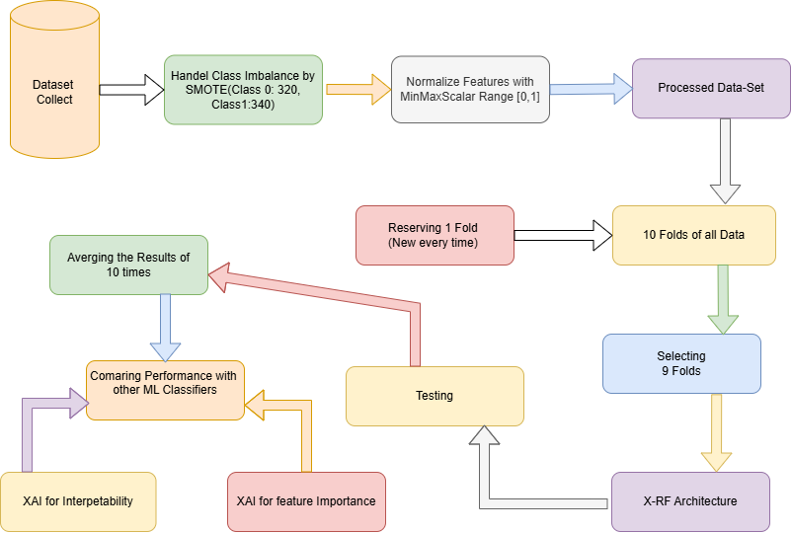
METHODOLOGY

Slide 16
METHODOLOGY (Cond..)
DATA SET
Collect Early Stage Diabetes Risk Prediction Dataset from www.kaggle.com. We have 520 rows and 17 columns of pieces of information data.
Data set Link: https://www.kaggle.com/datasets/ishandutta/early-stage-diabetes-risk-prediction-dataset/data
Process the data according to our requirements.

Slide 17
METHODOLOGY (Cond..)
DATA PREPROCESSING
The preprocessing techniques used in this research include:
Convert the category data into numeric data used Label Encoding.
Splitting data into feature and class attributes.
Synthetic Minority Over-sampling Technique (SMOTE) to address class imbalance.
Separation of class labels from feature attributes.
Normalization of feature variables using MinMaxScaler.
Split data into train and test data

Slide 18
METHODOLOGY (Cond..)
MODEL SELECTION
We selected five machine learning classifiers
Random Forest (RF)
Support Vector Machine (SVM)
Decision Tree (DT)
Linear Regression (LR)
Extra Tree (ET)

Slide 19
METHODOLOGY (Cond..)
Model Tuning
Hyperparameter Tuning: Use RandomizedSearchCV with 10-fold cross-validation to identify optimal hyperparameters for each model.
Divide Dataset: Split the dataset into 10 equal segments (10-fold cross-validation).
Training and Testing:
- For each fold, train the model on 9 segments.
- Test the model on the remaining 1 segment.
Repeat Across Folds: Perform this process for all 10 folds, allowing each segment to serve as the test set once.
Average Results: Calculate final performance metrics by averaging results across all folds for a comprehensive evaluation.

Slide 20
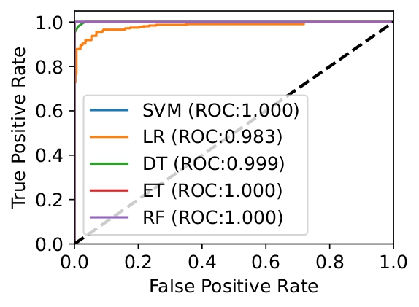
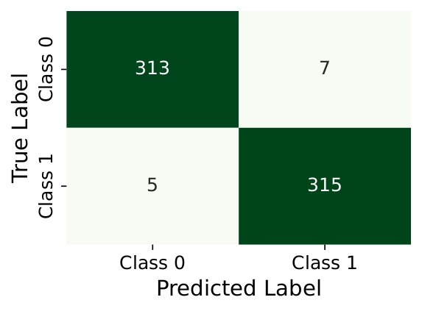
RESULT & DISCUSSION
BEST PARAMETERS FOR EACH MODEL
Fig 1: Confusion Matrix by X-RF.
Fig 2: ROC-AUC for All classifiers
The confusion matrix in Fig. 1 for the RF model, using 640 samples, shows accurate predictions with 313 correctly classified instances of class '0' and 315 of class '1', while only 5 instances of class '0' and 7 of class '1' are misclassified. This indicates the model’s high accuracy and effective class differentiation, accurately classifying the majority of instances in both classes.

Slide 21
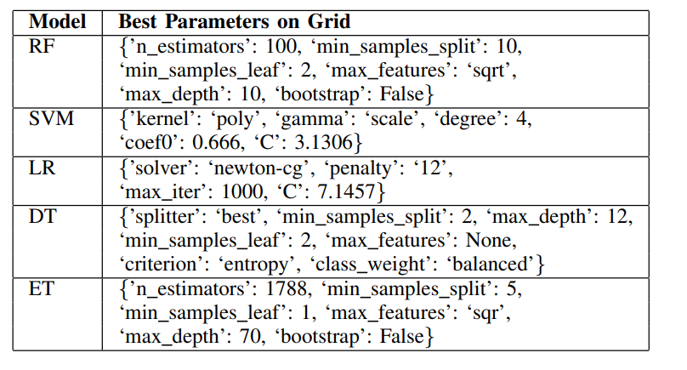
RESULT & DISCUSSION (Cond..)
BEST PARAMETERS FOR EACH MODEL

Slide 22
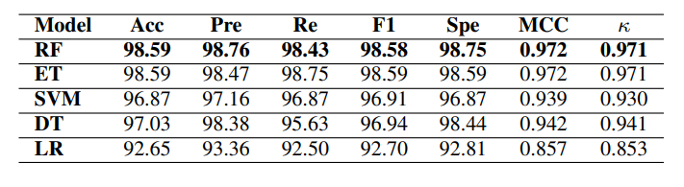
RESULT & DISCUSSION (Cond..)
PERFORMANCE METRICS OF THE CLASSIFIERS

Slide 23
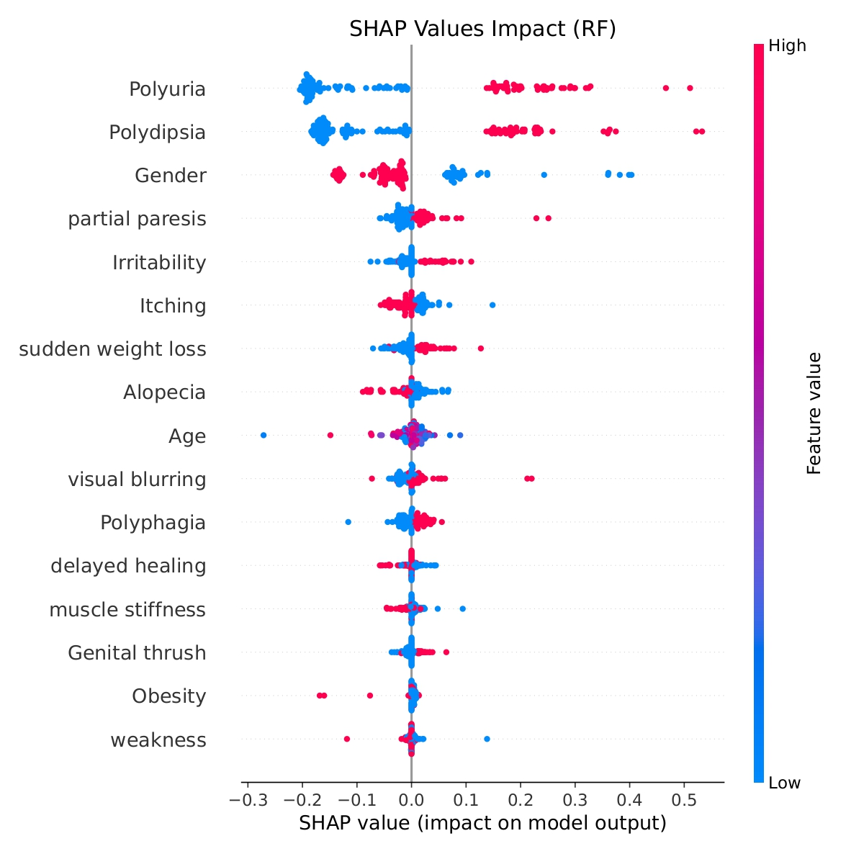
RESULT & DISCUSSION (Cond..)
SHAPLEY ADDITIVE EXPLANATIONS (SHAP)
SHAP (Shapley Additive Explanations): This section explains the SHAP values for the top model, showing how each feature impacts predictions. The SHAP summary plot (Fig. 3) ranks features by importance on the y-axis, with SHAP values on the x-axis. Positive values push predictions toward class '1,' while negative values steer them toward class '0.' "Polyuria" is the most impactful feature, followed by "Gender" and "Polydipsia," while "Obesity" and "Weakness" have less influence, clearly indicating feature relevance in the model.
Fig 3: SHAP Explanation (RF)

Slide 24
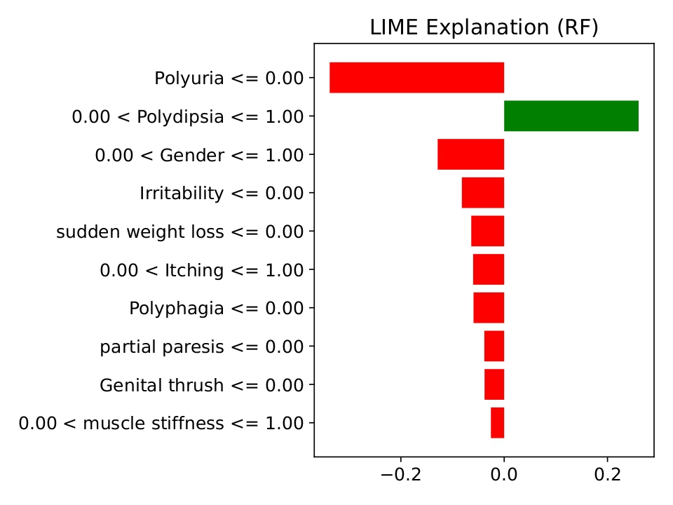
RESULT & DISCUSSION (Cond..)
LIME (Local Interpretable Model-agnostic Explanations)
This section explores how LIME helps interpret the Random Forest model’s predictions. The LIME plot (Fig. 4) shows each feature's influence, with attribution scores on the x-axis. Bars extending right contribute positively, pushing the prediction towards class '1,' while bars on the left contribute negatively, steering it towards class '0.' After scaling, scores range from 0 to 1. Features like “Polyuria <= 0.00” and “Gender <= 1.00” steer predictions towards class '0,' while “Polydipsia <= 1.00” moves it towards class '1.' The RF model achieves high accuracy with a 0.98 probability for class '0.'
Fig 4: LIME Explanation (RF)

Slide 25
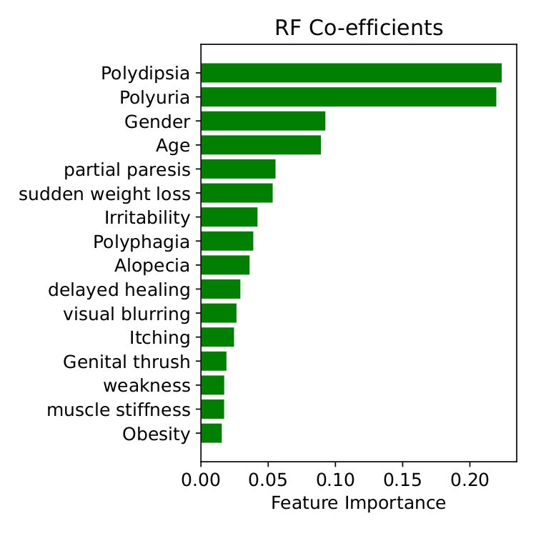
RESULT & DISCUSSION (Cond..)
XAI FOR FEATURE IMPORTANCE
Importance by Coefficients (ICE): Feature coefficients indicate their impact on predictions, with larger values driving predictions toward class '1' and smaller values toward class '0.' In Fig. 5, features like "Polyuria," "Polydipsia," "Age," and "Gender" have strong positive coefficients, while "Itching," "Weakness," "Obesity," and "Muscle Stiffness" have lower influence. "Alopecia" and "Polyphagia" show moderate coefficients, suggesting a balanced or slightly negative effect on predictions.
Fig 5: ICE of RF Classifier

Slide 26
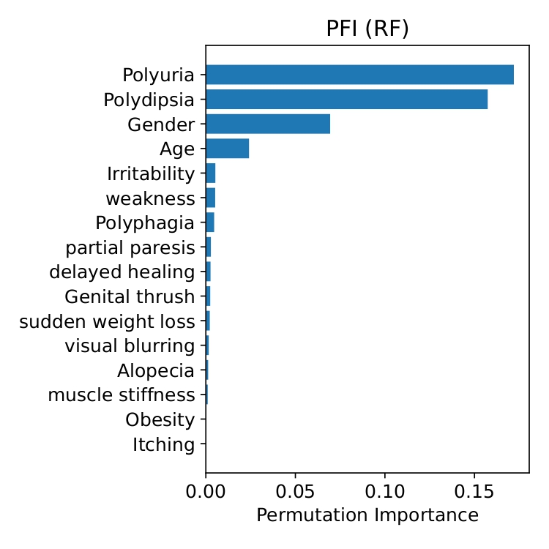
RESULT & DISCUSSION (Cond..)
PERMUTATION FEATURE IMPORTANCE (PFI)
PFI evaluates each feature's significance by measuring changes in model performance when feature values are shuffled. In Fig. 6, a bar plot shows the importance of features in the RF model, with values from 0.00 to 0.15. Features like "Itching," "Obesity," "Muscle Stiffness," and "Weakness" show low importance, while "Polyuria," "Polydipsia," "Gender," and "Age" are most influential, emphasizing their key role in predictions.
Fig 6: PFI of RF Classifier

Slide 27
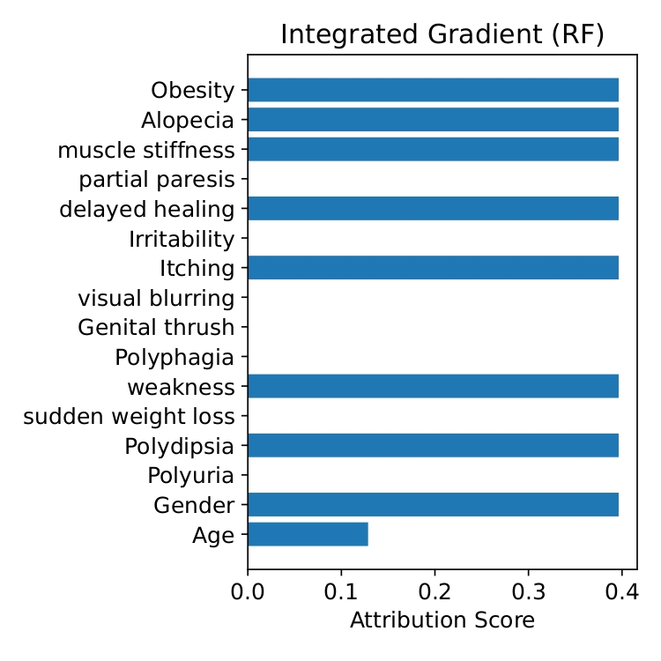
RESULT & DISCUSSION (Cond..)
INTEGRATED GRADIENTS (IG)
IG plots show how each feature influences the RF model’s predictions, with positive bars indicating supportive contributions and negative bars showing negative impacts. In Fig. 7, features like "Obesity," "Alopecia," "Muscle Stiffness," "Delayed Healing," "Itching," "Weakness," "Polydipsia," and "Gender" are strong positive contributors. "Age" has a moderate impact, while features like "Partial Paresis," "Visual Blurring," and "Polyphagia" have limited effect, indicating neutral influence on class '0' predictions.
Fig 7: Explanation by IG (RF)

Slide 28
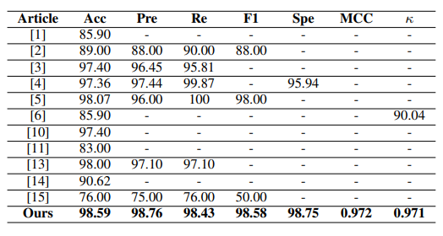
COMPARATIVE ANALYSIS
XAI FOR FEATURE IMPORTANCE
This study evaluates five classifiers for predicting early-stage diabetes using the Early Stage Diabetes Risk Prediction Dataset. The X-RF model performs best, with 98.59% accuracy and an F1-score of 98.58%, demonstrating strong precision and recall. This model effectively handles complex, non-linear relationships and class imbalance. XAI techniques improve model interpretability, highlighting key features.

Slide 29
CONCLUSION
This study demonstrates the effectiveness of using machine learning, particularly the Explainable Random Forest (X-RF) model, for early-stage diabetes prediction. By evaluating five classifiers—Random Forest (RF), Logistic Regression (LR), Support Vector Machine (SVM), Decision Tree (DT), and Extra Trees (ET)—the Random Forest model emerged as the most accurate to handle complex relationships and class imbalances with superior performance, making it highly reliable for diabetes prediction.

Slide 30
REFERENCE
[1] L. Kopitar, P. Kocbek, L. Cilar, A. Sheikh, and G. Stiglic, “Early detection of type 2 diabetes mellitus using machine learning-based prediction models,” Scientific reports, vol. 10, no. 1, p. 11981, 2020.
[2] H. Kaur and V. Kumari, “Predictive modelling and analytics for diabetes using a machine learning approach,” Applied computing and informatics, vol. 18, no. 1/2, pp. 90–100, 2022.
[3] A. YAS¸AR, “Data classification of early-stage diabetes risk prediction datasets and analysis of algorithm performance using feature extraction methods and machine learning techniques,” International Journal of Intelligent Systems and Applications in Engineering, vol. 9, no. 4, pp. 273–281, 2021.
[4] D. S. Khafaga, A. H. Alharbi, I. Mohamed, and K. M. Hosny, “An integrated classification and association rule technique for early-stage diabetes risk prediction,” in Healthcare, vol. 10, p. 2070, MDPI, 2022.
[5] N. Elsayed, Z. ElSayed, and M. Ozer, “Early stage diabetes prediction via extreme learning machine,” in SoutheastCon 2022, pp. 374–379, IEEE, 2022.
[6] V. Wijayaningrum, T. Saragih, and N. Putriwijaya, “Optimal multilayer perceptron parameters for early stage diabetes risk prediction,” in IOP Conference Series: Materials Science and Engineering, vol. 1073, p. 012070, IOP Publishing, 2021.
[7] O. N. Erg ¨ un¨ et al., “Early stage diabetes prediction using machine learning methods,” Avrupa Bilim ve Teknoloji Dergisi, no. 29, pp. 52–57, 2021.
[8] M. Zarar and Y. Wang, “Early stage diabetes prediction by approach using machine learning techniques,” 2023.

Slide 31
REFERENCE (Cond..)
[9] V. Vakil, S. Pachchigar, C. Chavda, and S. Soni, “Explainable predictions of different machine learning algorithms used to predict early stage diabetes,” arXiv preprint arXiv:2111.09939, 2021.
[10] A. Y. Abushawish and A. B. Nassif, “Prediction of early-stage diabetes using machine learning,” in 2023 Advances in Science and Engineering Technology International Conferences (ASET), pp. 1–4, IEEE, 2023.
[11] M. A. R. Refat, M. Al Amin, C. Kaushal, M. N. Yeasmin, and M. K. Islam, “A comparative analysis of early stage diabetes prediction using machine learning and deep learning approach,” in 2021 6th International Conference on Signal Processing, Computing and Control (ISPCC), pp. 654–659, IEEE, 2021.
[12] S. Gundo ¨ gdu, “Efficient prediction of early-stage diabetes using xgboost ˘ classifier with random forest feature selection technique,” Multimedia Tools and Applications, vol. 82, no. 22, pp. 34163–34181, 2023.
[13] U. E. Laila, K. Mahboob, A. W. Khan, F. Khan, and W. Taekeun, “An ensemble approach to predict early-stage diabetes risk using machine learning: An empirical study,” Sensors, vol. 22, no. 14, p. 5247, 2022.
[14] S. Samet, M. R. Laouar, and I. Bendib, “Diabetes mellitus early stage risk prediction using machine learning algorithms,” in 2021 International Conference on Networking and Advanced Systems (ICNAS), pp. 1–6, IEEE, 2021.
[15] X. Chen, S. Zhou, L. Yang, Q. Zhong, H. Liu, Y. Zhang, H. Yu, and Y. Cai, “Risk prediction of diabetes progression using big data mining with multifarious physical examination indicators,” Diabetes, Metabolic Syndrome and Obesity, pp. 1249–1265, 2024.
[16] “Early stage diabetes risk prediction - uci machine learning repository.” https://archive.ics.uci.edu/dataset/529/early+stage+diabetes+risk+ prediction+dataset. (Accessed on 09/01/2024).

Slide 32
Thank You

